Slide 1


Accountable Virtual Machines
Andreas Haeberlen
University of Pennsylvania
Paarijaat Aditya Rodrigo Rodrigues Peter Druschel Max Planck Institute for Software Systems (MPI-SWS)
Max
Planck
Institute
for
Software Systems

Slide 2





Scenario: Multiplayer game
I'd like to play a game
Charlie
Network
Alice
Bob
Alice decides to play a game of Counterstrike with Bob and Charlie

Slide 3
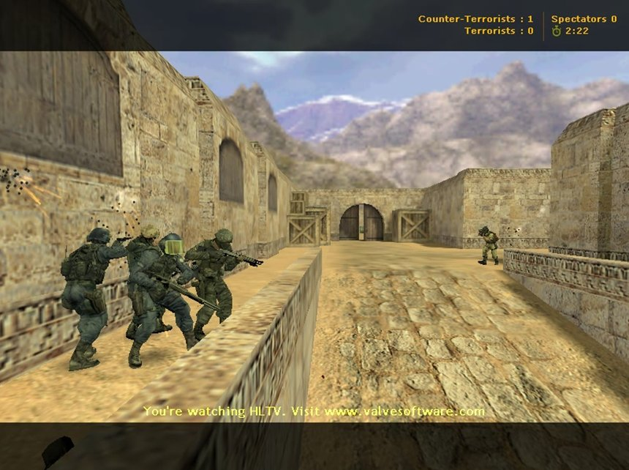
What Alice sees
Movie
Alice

Slide 4
Could Bob be cheating?
Ammo
Charlie
35
36
37
Network
Alice
Bob
In Counterstrike, ammunition is local state
  Bob can manipulate counter and prevent it from decrementing
  Such cheats (and many others) do exist, and are being used

Slide 5



This talk
is not (just) about cheating!
Software
Alice
Network
Bob
Cheating is a serious problem in itself
  Multi-billion-dollar industry
But we address a more general problem:
  Alice relies on software that runs on a third-party machine
  Examples: Competitive system (auction), federated system...
  How does Alice know if the software running as intended?

Slide 6
Goal: Accountability
Software
Alice
Network
Bob
We want Alice to be able to
  Detect when the remote machine is faulty
  Obtain evidence of the fault that would convince a third party
Challenges:
  Alice and Bob may not trust each other
    Possibility of intentional misbehavior (example: cheating)
  Neither Alice nor Bob may understand how the software works
    Binary only - no specification of the correct behavior

Slide 7
Outline
Problem: Detecting faults on remote machines
  Example: Cheating in multiplayer games
Solution: Accountable Virtual Machines
Evaluation
  Using earlier example (cheating in Counterstrike)
Summary
NEXT

Slide 8


Overview
Accountable
Virtual Machine
(AVM)
Log
AVM
Virtual
machine
image
Accountable
Virtual Machine Monitor (AVMM)
AVMM
Network
Alice must trust her own reference image
Alice
Bob
What if Bob manipulates the log?
How can Alice find this execution, if it exists?
Bob runs Alice's software image in an AVM
  AVM maintains a log of network in-/outputs
Alice can check this log with a reference image
  AVM correct: Reference image can produce same network outputs when started in same state and given same inputs
  AVM faulty: Otherwise

Slide 9


Tamper-evident logging
AVM
474: SEND(Alice, Firing)
473: SEND(Charlie, Got ammo)
472: RECV(Alice, Got medipack)
471: SEND(Charlie, Moving left)
...
AVMM
Firing
Moving right
Message log is tamper-evident [SOSP'07]
  Log is structured as a hash chain
  Messages contain signed authenticators
Result: Alice can either...
  ... detect that the log has been tampered with, or
  ... get a complete log with all the observable messages

Slide 10
Execution logging
AVM
474: SEND(Alice, Firing)
473: Mouse button clicked
472: SEND(Charlie, Got ammo)
471: RECV(Alice, Got medipack)
470: Got network interrupt
469: SEND(Charlie, Moving left)
474: SEND(Alice, Firing)
473: SEND(Charlie, Got ammo)
472: RECV(Alice, Got medipack)
471: SEND(Charlie, Moving left)
...
AVMM
How does Alice know whether the log matches a correct execution of her software image?
Idea: AVMM can specify an execution
  AVMM additionally logs all nondeterministic inputs
  AVM correct: Can replay inputs to get execution
  AVM faulty: Replay inevitably (!) fails

Slide 11
Auditing and replay
373: SEND(Alice, Firing)
372: SEND(Alice, Firing)
371: SEND(Alice, Firing)
371: SEND(Alice, Firing)
370: SEND(Alice, Firing)
370: SEND(Alice, Firing)
369: SEND(Alice, Firing)
369: SEND(Alice, Firing)
368: Mouse button clicked
368: Mouse button clicked
367: SEND(Alice, Got medipack)
367: SEND(Alice, Got medipack)
366: Mouse moved left
366: Mouse moved left
...
Modification
AVM
Evidence
AVM
AVMM
AVMM
Network
Alice
Bob

Slide 12
AVM properties
Strong accountability
  Detects faults
  Produces evidence
  No false positives
Works for arbitrary, unmodified binaries
  Nondeterministic events can be captured by AVM Monitor
Alice does not have to trust Bob, the AVMM, or any software that runs on Bob's machine
  If Bob tampers with the log, Alice can detect this
  If Bob's AVM is faulty, ANY log Bob could produce would inevitably cause a divergence during replay
If it runs in a VM, it will work

Slide 13
Outline
Problem: Detecting faults on remote machines
  Example: Cheating in multiplayer games
Solution: Accountable Virtual Machines
Evaluation
  Using earlier example (cheating in Counterstrike)
Summary
NEXT

Slide 14
Methodology
We built a prototype AVMM
  Based on logging/replay engine in VMware Workstation 6.5.1
  Extended with tamper-evident logging and auditing
Evaluation: Cheat detection in games
  Setup models competition / LAN party
  Three players playing Counterstrike 1.6
  Nehalem machines (i7 860)
  Windows XP SP3

Slide 15
Evaluation topics
Effectiveness against real cheats
Overhead
  Disk space (for the log)
  Time (auditing, replay)
  Network bandwidth (for authenticators)
  Computation (signatures)
  Latency (signatures)
Impact on game performance
Online auditing
Spot checking tradeoffs
  Using a different application: MySQL on Linux
Please refer to
the paper for
additional results!

Slide 16
AVMs can detect real cheats
Event timing (for replay)
98: RECV(Alice, Hit)
98: RECV(Alice, Missed)
97: SEND(Alice, Fire@(3,9))
96: Mouse button clicked
95: Interrupt received
94: RECV(Alice, Jumping)
...
BC=53
BC=52
BC=47BC=44
BC=37
...
BC=59
BC=54
BC=49BC=44
BC=37
...
EIP=0xb382
EIP=0x3633
EIP=0xc490
EIP=0x6771
EIP=0x570f
...
EIP=0x861e
EIP=0x2d16
EIP=0xc43e
EIP=0x6771
EIP=0x570f
...
97: SEND(Alice, Fire@(2,7))
AVM
AVMM
Bob's log
If the cheat needs to be installed in the AVM to be effective, AVM can trivially detect it
  Reason: Event timing + control flow change
  Examined real 26 cheats from the Internet; all detectable

Slide 17
AVMs can detect real cheats
99: RECV(Alice, Hit)
98: SEND(Alice, Fire@(2,7))
97: Mouse button clicked
96: Mouse move right 1 inch
94: Mouse move up 1 inch
92: RECV(Alice, Jumping)
...
BC=
BC=
BC=
BC=
BC=
BC=
...
EIP=
EIP=
EIP=
EIP=
EIP=
EIP=
...
?
?
?
96: RECV(Alice, Missed)
95: SEND(Alice, Fire@(3,9))
94: Mouse button clicked
93: Interrupt received
92: RECV(Alice, Jumping)
...
BC=53
BC=52
BC=47BC=44
BC=37
...
EIP=0xb382
EIP=0x3633
EIP=0xc490
EIP=0x6771
EIP=0x570f
...
AVM
?
?
?
?
?
?
AVMM
?
?
Couldn't cheaters adapt their cheats?
There are three types of cheats:
  Detection impossible (Example: Collusion)
  Detection not guaranteed, but evasion technically difficult
  Detection guaranteed (≥15% of the cheats in our sample)

Slide 18
Impact on frame rate
200
Different machines with different players
-11%
150
∅158fps
-13%
100
Average frame rate
No fps cap
Window mode
800x600
Softw. rendering
50
0
Bare
hardware
VMware
(no logging)
VMware
(logging)
AVMM
(no crypto)
AVMM
Frame rate is ~13% lower than on bare hw
  137fps is still a lot! 60--80fps generally recommended
  11% due to logging; additional cost for accountability is small

Slide 19
Cost of auditing
12
Added by
accountability
10
~8 MB
per minute
8
2.47 MB
per minute
(compressed)
6
Average log growth (MB/minute)
4
2
0
VMware
AVMM
When auditing a player after a one-hour game,
  How big is the log we have to download?
  How much time is needed for replay?
148 MB
~ 1 hour

Slide 20

Online auditing
Game
Logging
Replay
Replay
200
150
Alice
100
Average frame rate
50
Bob
Charlie
0
No online
auditing
One audit
per player
Two audits
per player
Idea: Stream logs to auditors during the game
  Result: Detection within seconds after fault occurs
  Replay can utilize unused cores; frame rate penalty is low

Slide 21
Summary
Accountable Virtual Machines (AVMs) offer strong accountability for unmodified binaries
  Useful when relying on software executing on remote machines: Federated system, multiplayer games, ...
  No trusted components required
AVMs are practical
  Prototype implementation based on VMware Workstation
  Evaluation: Cheat detection in Counterstrike
Questions?

Slide 22
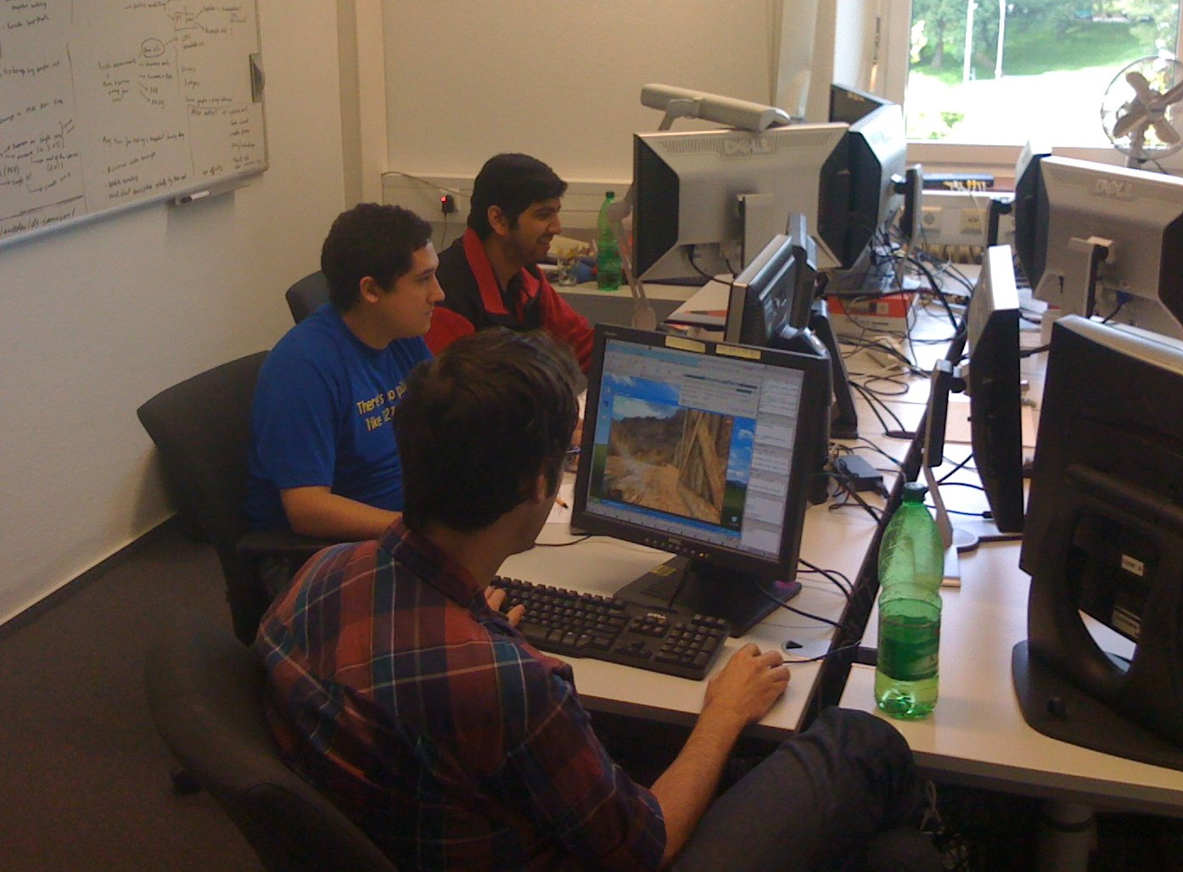
Thank you!
Our enthusiastic Counterstrike volunteers

